Slide 1

Advanced Skin Diseases Diagnosis Leveraging Image Processing
TEAM:
Rohith Dasari
Huma Samreen
Noraiz Amaan
Jeeva Santra G
Preethi S P
MENTOR:
SANGEETHA MAHALINGAM

Slide 2
INTRODUCTION
Problem Statement
Skin diseases impact millions globally, ranging from benign conditions to serious cancers like melanoma, requiring accurate and timely diagnosis for effective treatment.
Traditional diagnostic methods rely on visual inspections by dermatologists, which can be subjective and prone to human error.
Existing challenges include limited and imbalanced dermatological datasets, necessitating advanced automated solutions to improve diagnostic accuracy and efficiency.
Objective
Develop a robust methodology for skin disease detection by integrating image processing and deep learning techniques, focusing on eight prevalent conditions.
Utilize ResNet for efficient feature extraction and SVM for high-dimensional classification, leveraging data augmentation, transfer learning, and hyperparameter optimization to enhance model performance.
Establish performance benchmarks and design scalable, reliable diagnostic tools for clinical and remote healthcare applications.

Slide 3
EXISTING SYSTEM
Adoption of Support Vector Machines (SVM)
Effective for high-dimensional data and non-linear boundaries.
Esteva et al. (2017) demonstrated high accuracy with feature extraction techniques.
Limitations: Handcrafted features (e.g., color histograms) insufficient for capturing complex patterns.
Convolutional Neural Networks (CNNs)
Revolutionized dermatological diagnostics with hierarchical feature learning.
Architectures like ResNet and Inception excel in skin lesion classification.
Gulshan et al. (2016): Used CNNs for diabetic retinopathy detection and extended them to skin disease classification with superior results.

Slide 4
EXISTING SYSTEM
Hybrid Approaches
Combination of CNNs (for feature extraction) and SVM (for classification):
Achieved refined decision boundaries.
Improved accuracy and reduced computational overhead.
Jafari et al. (2020) showcased the effectiveness of this approach.
Segmentation Techniques
Critical for preprocessing and isolating regions of interest.
Methods used: Otsu's method, k-means clustering, active contour models.
Noise and artifacts addressed using Gaussian and median filters.
Challenges: Segmentation accuracy sensitive to noise and image artifacts.
Challenges in Current Research
Creation of unbiased, diverse training datasets remains a challenge.
Addressing performance disparities across different demographic groups is critical..

Slide 5
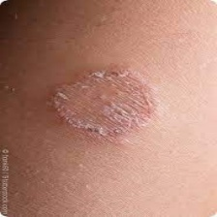
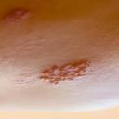
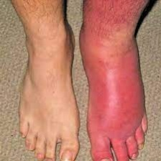
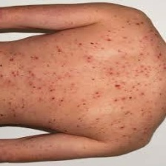
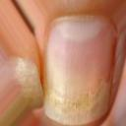
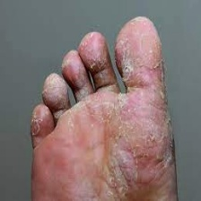
DATASET
Dataset Size: Each category contains approximately 100 to 150 images.
SOURCE: Skin disease dataset obtained from Kaggle
CATEGORIES
'VI-shingles'
'VI-chickenpox'
'BA-cellulitis'
'FU-athlete-foot'
'BA-impetigo'
'FU-nail-fungus'
'FU-ringworm'
'PA-cutaneous-larva-migrans'

Slide 6
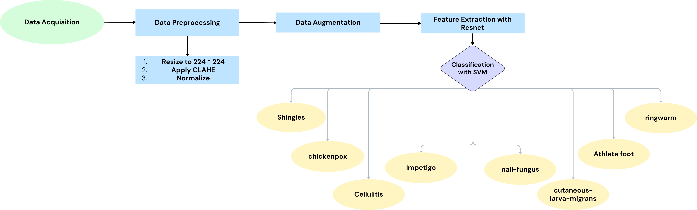
Methodology
Fig. 1 Proposed work flow
1. Data Preparation
Dataset Loading: Loaded training and testing datasets from Kaggle's skin disease dataset, categorized into eight classes.
Preprocessing:
Resized images to 224x224 for ResNet input.
Applied CLAHE for contrast enhancement.
Normalized pixel values to [0,1] and used ResNet50 preprocessing.

Slide 7
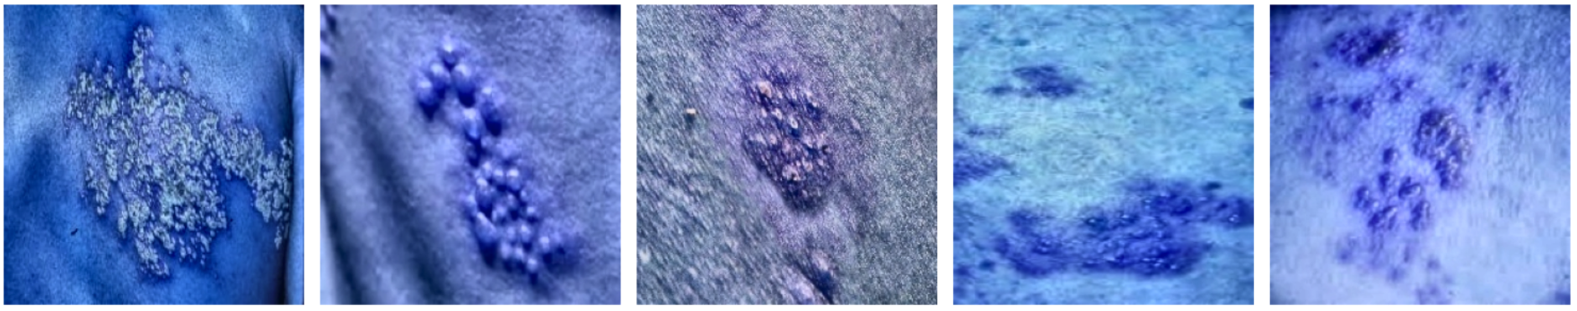
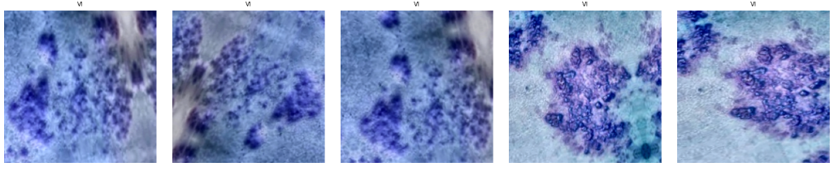
Fig. 2 Pre-processed Images
Fig. 3 Augmented Samples
2. Data Augmentation
Techniques:
Random rotations, width and height shifts, shear transformations, zooming, and horizontal flipping.
Expanded dataset size artificially to address class imbalance and enhance generalization.

Slide 8
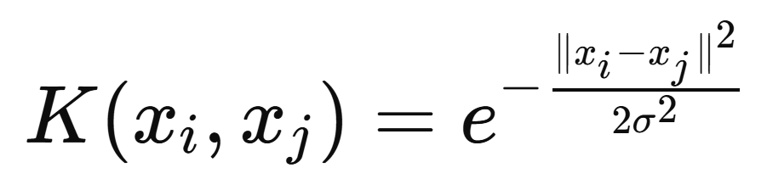
3. Feature Extraction
Model:
Used ResNet50 pre-trained on ImageNet for extracting high-level features.
Advantages: Skip connections in ResNet address vanishing gradient problems and facilitate efficient feature learning.
Process:
Extracted deep features from intermediate layers.
Flattened feature maps for compatibility with the SVM classifier.
4. Classification
Classifier:
Employed Support Vector Machine (SVM) with RBF kernel for multi-class classification.
SVM effectively handles high-dimensional feature spaces and defines non-linear decision boundaries.
5. Evaluation
Metrics: Used accuracy, classification report, and confusion matrix to evaluate performance.
Visualization: Displayed test results with actual vs. predicted labels using matplotlib to assess classifier reliability.

Slide 9
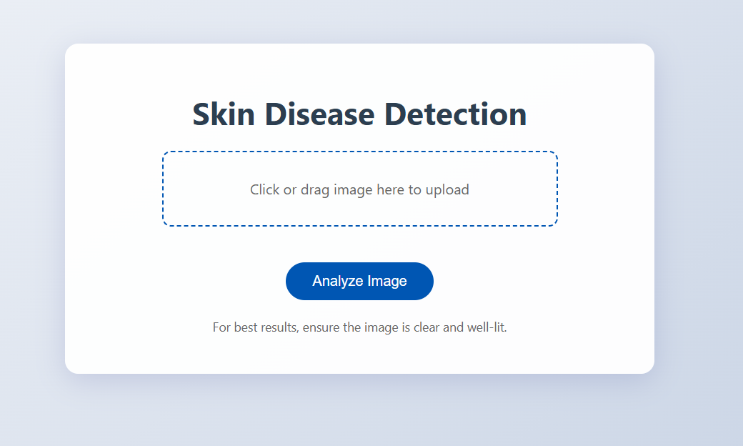
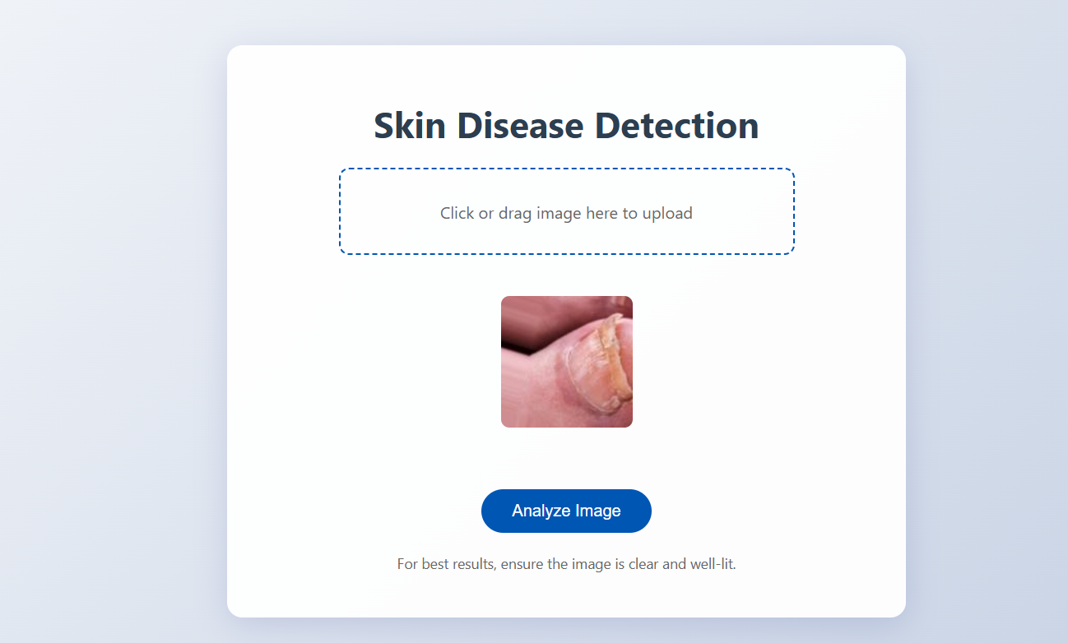
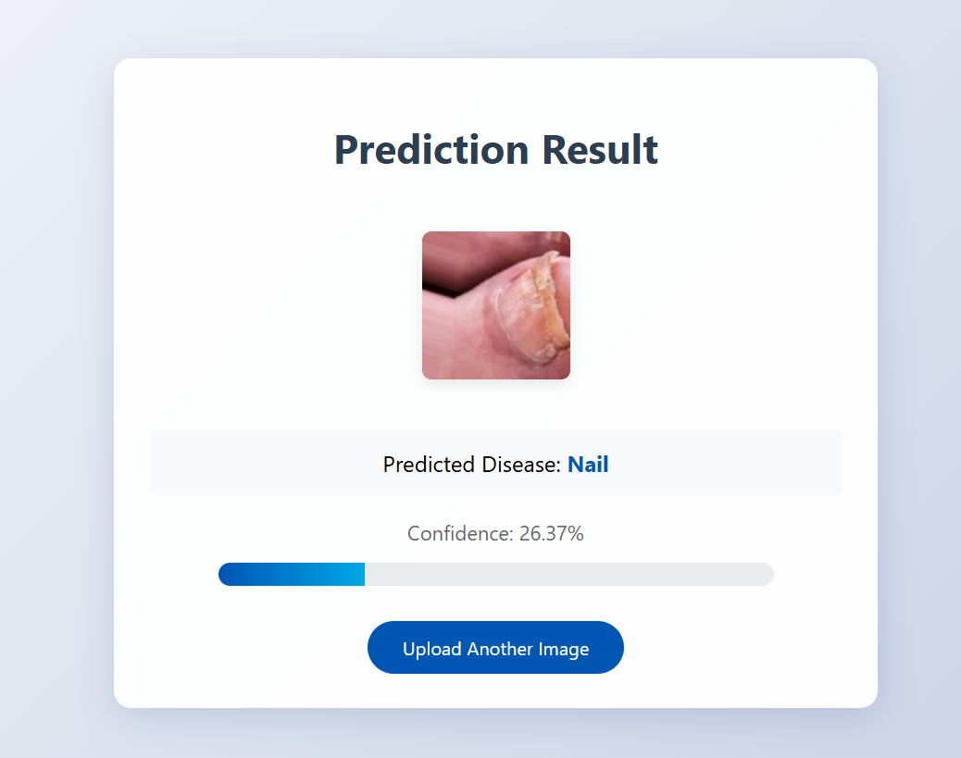
6. Interface
HTML: Created index and result html files for frontend where user can upload image
Flask: Uploaded images is given to stored model to make the prediction which is displayed in result.html
Fig. 4-6 Interface Images

Slide 10
Implementation Details
Software Requirements
Operating System: Windows 10/11, macOS, or Linux
Programming Language: Python 3.8 or above.
Libraries and Frameworks:
TensorFlow (2.x)
Scikit-learn
OpenCV
Matplotlib
NumPy
Pandas
Development Environment:
Jupyter Notebook, VS Code, or PyCharm.
Hardware Requirements
Processor: Intel Core i5 or higher / AMD Ryzen 5 or higher (minimum 4 cores).
RAM: At least 16 GB (32 GB recommended for large datasets and faster processing).
GPU: NVIDIA GPU with at least 4 GB VRAM (e.g., NVIDIA GTX 1050 Ti or higher, RTX series recommended).
Storage: Minimum 20 GB free disk space for dataset and model storage.

Slide 11
Evaluation metrics and Results
Accuracy: The overall accuracy of the model is 94%, showing strong performance across all classes.
Macro Average Precision, Recall, F1-Score: Scores are 0.95, 0.93, and 0.94, respectively, indicating balanced performance across all categories.
Category-Specific Insights:
VI-chickenpox: Achieved perfect precision, recall, and F1-score.
BA-cellulitis: The lowest precision (0.76), suggesting room for improvement in feature representation.
Other categories: Precision, recall, and F1-scores are consistently high, with minor variations.
Model | Accuracy | Macro Avg F1-Score | Weighted Avg F1-Score
ResNet-SVM | 0.94 | 0.94 | 0.94
VGG16-SVM | 0.87 | 0.86 | 0.87
Table: Comparison of ResNet-SVM and VGG-SVM

Slide 12
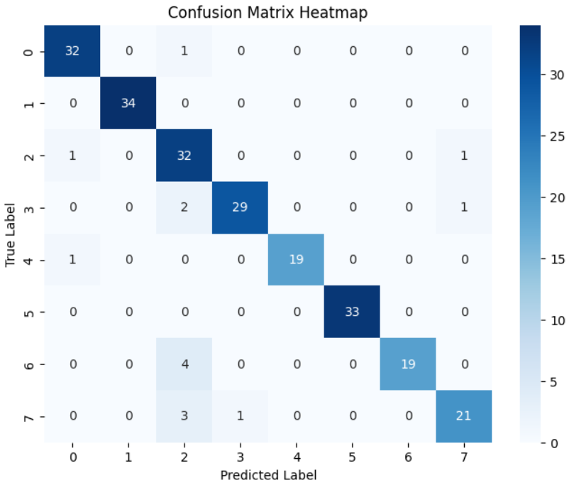
Fig. 7 Confusion Matrix of Resnet-SVM

Slide 13

Why Resnet50 outperformed VGG16?
While VGG16 is effective, its simpler design and absence of skip connections limit its ability to efficiently handle deeper architectures and complex patterns compared to ResNet.
Skip connections in ResNet mitigate the vanishing gradient issue, allowing deeper networks to train efficiently without degrading performance.

Slide 14
Challenges and Solutions
Noise and Artifacts in Images
Robust preprocessing pipelines, including Gaussian filtering and ResNet's preprocessing, minimized the impact of noise.
Careful manual verification of dataset images ensured the inclusion of only high-quality samples
Variability in Skin Conditions
Preprocessing techniques, such as CLAHE (Contrast Limited Adaptive Histogram Equalization), were used to enhance image quality and improve consistency.
The robust feature extraction capabilities of ResNet ensured better handling of varying lesion sizes, textures, and colors.
Limited and Imbalanced Dataset
Data augmentation techniques (rotation, flipping, zooming) were applied to artificially expand the dataset and introduce diversity.
Transfer learning using ResNet50 helped leverage features learned from large datasets like ImageNet.
Addressed class imbalance using weighted metrics during evaluation.

Slide 15
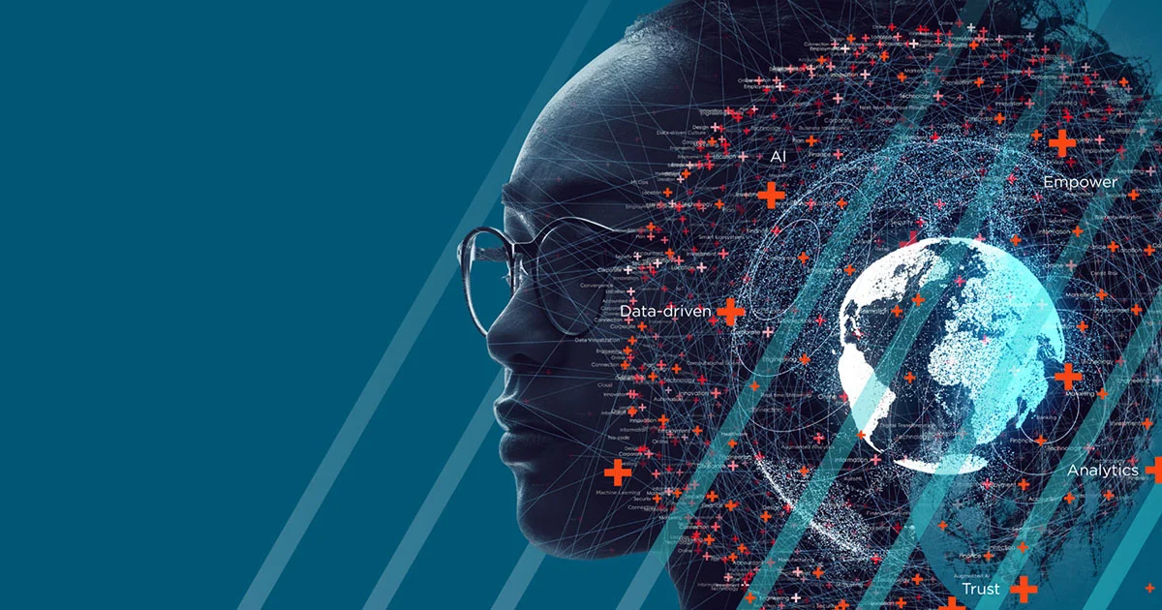
CONCLUSION
The project developed a skin disease detection model using ResNet50, outperforming VGG in feature extraction and classification. Key preprocessing techniques like resizing, CLAHE for contrast enhancement, and ResNet50-specific normalization contributed to improving model performance.
With an overall accuracy of 94%, and strong Macro Average Precision (0.95), Recall (0.93), and F1-Score (0.94), the model demonstrated balanced classification across categories. VI-chickenpox achieved perfect scores, while BA-cellulitis showed room for improvement (precision of 0.76). Overall, the model provides reliable skin disease detection with potential for further optimization.

Slide 16

FUTURE SCOPE
Deep Learning Model Enhancements:
Experiment with advanced architectures like EfficientNet, Vision Transformers, or DenseNet.
Explore end-to-end deep learning models for direct classification.
Real-Time Prediction:
Develop a mobile or web application for real-time skin disease detection.
Deploy lightweight models for edge devices (e.g., smartphones).
Explainable AI (XAI):
Implement explainability techniques like Grad-CAM or SHAP for model transparency.
Data Augmentation and Synthetic Data:
Utilize advanced augmentation techniques and GANs to generate synthetic skin disease images.
Integration with Telemedicine:
Integrate the model into telemedicine platforms to assist doctors in diagnosing skin conditions remotely.

Slide 17
THANK YOU!

